Slide 1
Biometric Backdoors

Slide 2
Project 1: Initial Things
10 images of 40 different people.
Facenet model for extracting embeddings (None, 128) features.
Normal features (None, 128) -> RDM() -> RDM features (None, 64)

Slide 3
Data Distribution
SVM model classification
We normalize both features. And plot PCA (with centroid for each class) for both of them.
We use normal linear kernel SVM classifier on both dataset.
97.5% for normal template features (None, 128)
100% for RDM template features (None, 64)

Slide 4
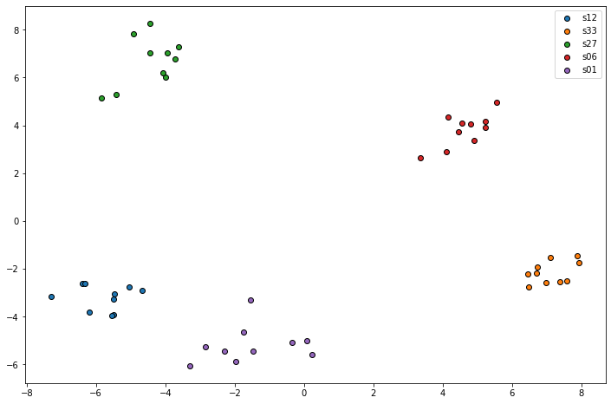
Project 2: Initial Things
We consider totalSubjects= 5 (['s12', 's33', 's27', 's06', 's01’]) and a kmeans system.

Slide 5
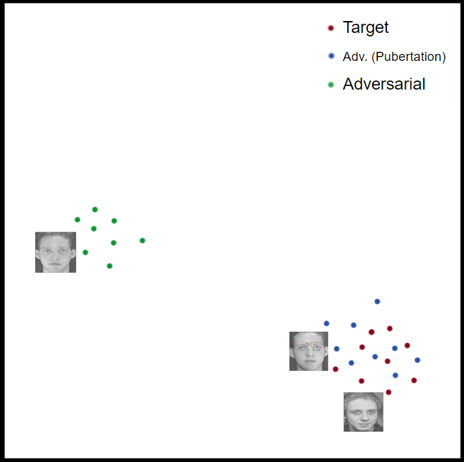
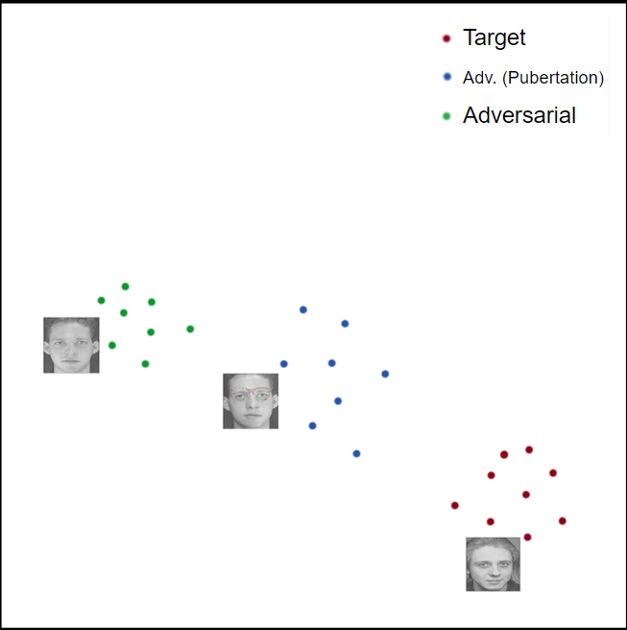
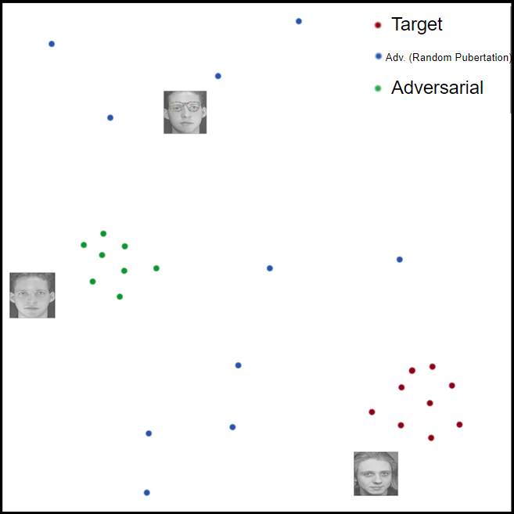
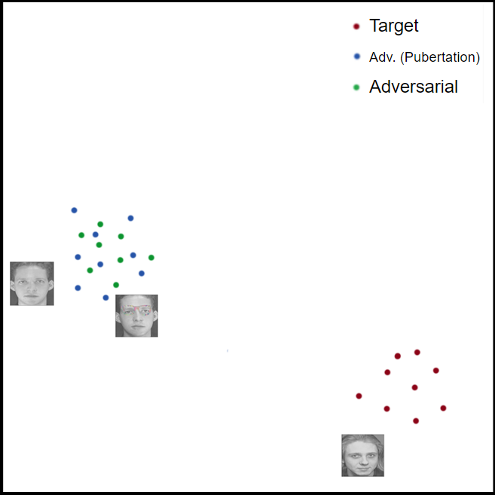
Attack Plan

